Slide 1
Using lists in Android

Slide 2
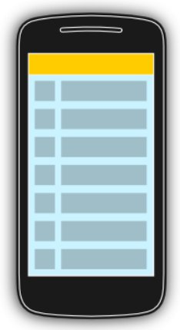
The display of elements in a list is a very common pattern in mobile applications.
The user sees a list of items and can scroll through them. Such an activity is depicted in the following picture.

Slide 3
Typically the user interacts with the list via the toolbar, for example, via a button which refreshes the list. Individual list items can be selected.
This selection can update the toolbar or can trigger a detailed screen for the selection. The following graphic sketches that. On the selection of a list item another activity is started.

Slide 4
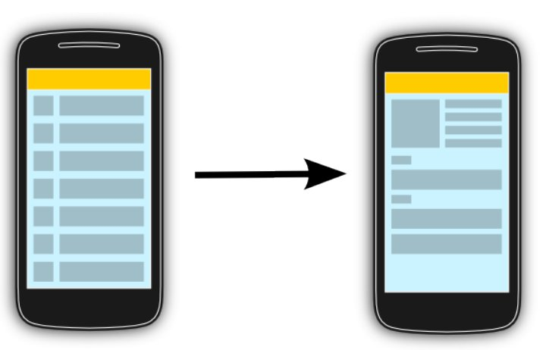

Slide 5
Android and the ListView widget
Android provides the ListView and the ExpandableListView classes which is capable of displaying a scrollable list of items.
The ExpandableListView class supports a grouping of items.
The input to the list (items in the list) can be arbitrary Java objects.

Slide 6
Adapters
The adapter extracts the correct data from the data object and assigns this data to the views in the row of the ListView.
Definition:
An adapter manages the data model and adapts it to the individual entries in the widget. An adapter extends the BaseAdapter class.

Slide 7
Using an ArrayAdapter with ListView
In Android development, any time we want to show a vertical list of scrollable items we will use a ListView which has data populated using an Adapter.
The simplest adapter to use is called an ArrayAdapter because the adapter converts an ArrayList of objects into View items loaded into the ListView container.

Slide 8
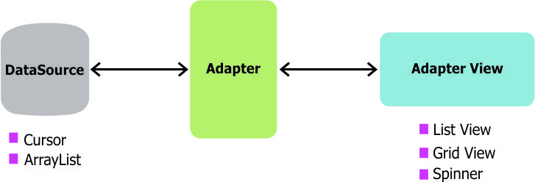

Slide 9
Row View Recycling
When using an adapter and a ListView, we need to make sure to understand how view recycling works.
When your ListView is connected to an adapter, the adapter will instantiate rows until the ListView has been fully populated with enough items to fill the full height of the list. At that point, no additional row items are created in memory.
I

Slide 10
Instead, as the user scroll through the list, items that leave the screen are kept in memory for later use and then every new row that enters the screen reuses an older row kept around in memory. In this way, even for a list of 1000 items, only ~7 item view rows are ever instantiated or held in memory. Here is a visual overview of recycling:

Slide 11
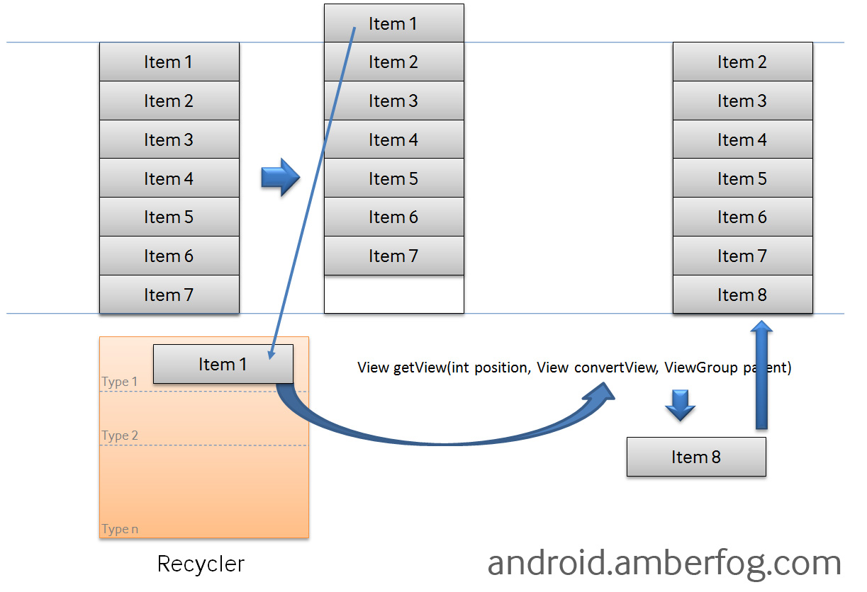

Slide 12
Using a Basic ArrayAdapter
To use a basic ArrayAdapter, you just need to initialize the adapter and attach the adapter to the ListView. First, we initialize the adapter:
ArrayAdapter<String> itemsAdapter =
new ArrayAdapter<String>(this, android.R.layout.simple_list_item_1, items);

Slide 13
The ArrayAdapter requires a declaration of the type of the item to be converted to a View (a String in this case) and then accepts three arguments: context (activity instance), XML item layout, and the array of data.
Note that we've chosen simple_list_item_1.xml which is a simple TextView as the layout for each of the items.

Slide 14
ListView listView = (ListView)
findViewById(R.id.lvItems);
listView.setAdapter(itemsAdapter);
By default, this will now convert each item in the data array into a view by calling toString on the item and then assigning the result as the value of a TextView (simple_list_item_1.xml) that is displayed as the row for that data item.

Slide 15
If the app requires a more complex translation between item and View then we need to create a custom ArrayAdapter instead.

Slide 16
Using a Custom ArrayAdapter
When we want to display a series of items into a list using a custom representation of the items, we need to use our own custom XML layout for each item.
To do this, we need to create our own custom ArrayAdapter

Slide 17
Defining the Model
public class User {
  public String hometown;
  public String name;
public User(String name, String hometown) {
this.name = name;
this.hometown = hometown;
}
}

Slide 18
Given a Java object that has certain fields defined such as a User class:
We can create a custom ListView of User objects by subclassing ArrayAdapter to describe how to translate the object into a view within that class and then using it like any other adapter.

Slide 19
Creating the View Template
Next, we need to create an XML layout that represents the view template for each item in res/layout/item_user.xml:

Slide 20
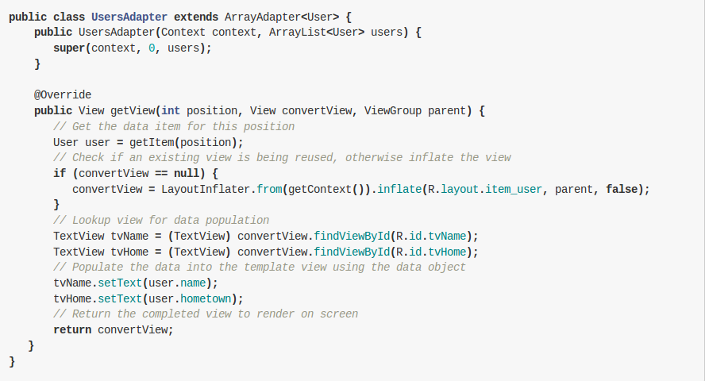

Slide 21
That adapter has a constructor and a getView() method to describe the translation between the data item and the View to display.
getView() is the method that returns the actual view used as a row within the ListView at a particular position. Another method used is getItem() which is already present in the ArrayAdapter class and its task is to simply get the data item associated with the specified position in the data set which is associated with that ArrayAdapter.

Slide 22
Attaching the Adapter to a ListView

